Slide 1



Slide 2

The utility of operators such as +, =, *, /, >, <, and so on is predefined in any programming language.
Programmers can use them directly on built-in data types to write their programs.
However, these operators do not work for user-defined types such as objects.
Therefore, C++ allows programmers to redefine the meaning of operators when they operate on class objects.
This feature is called operator overloading

Slide 3
Operator Overloading:
Operator – It is a symbol that indicates an operation. Arithmetic operators are + (add two numbers), - (subtract two numbers), * ( Multiply two numbers), / ( Divide between two numbers).
At now, we will take an Addition ‘+’ Sign, its use of ‘+’ sign is
5+5=10
2.5+2.5=5

Slide 4

Operator Overloading means multiple functions or multiple jobs. In operator overloading the ‘+’ sign use of add the two objects.
One of C++’s great features is its extensibility, Operator Overloading is major functionality related to extensibility.
In C++, most of operators can be overloaded so that they can perform special operations relative to the classes you create.

Slide 5
For Example, ‘+’ operator can be overloaded to perform an operation of string concatenation along with its pre-defined job of adding two numeric values.
When an operator is overloaded, none of its original meaning will be lost.
After overloading the appropriate operators, you can use C++’s built in data types.

Slide 6
Unary Operator
- Operators attached to a single operand. (-a, +a, --a, ++a, a--, a++)
Binary Operator
- Operators attached to two operand. (a-b, a+b, a*b, a/b, a%b, a>b, a<b )

Slide 7

return-type class-name:: operator op(arg-list)
{
function body
}
EXPLANATION
return type – It is the type of value returned by the specified operation.
op - It is the operator being overloaded. It may be unary or
binary operator. It is preceded by the keyword operator.
operator op - It is the function name, Where operator is a keyword.

Slide 8
Introduction
One of the exciting features of C++
Works only on the single variable
It can be overloaded two ways
Static member function
Friend function
-,+,++,-- those are unary operator which we can overloaded.

Slide 9
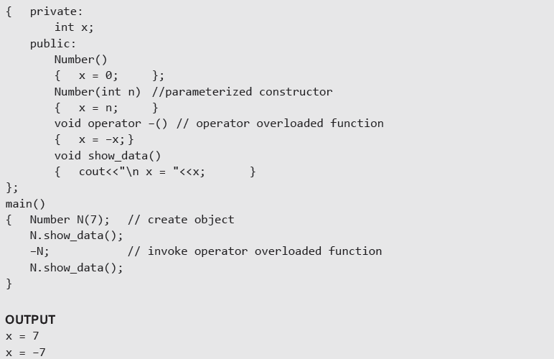
Using a member function to Overload Unary Operator

Slide 10
Using a Friend Function to Overload a Unary Operator
The function will take one operand as an argument.
This operand will be an object of the class.
The function will use the private members of the class only with the object name.
The function may take the object by using value or by reference.
The function may or may not return any value.
The friend function does not have access to the this pointer.

Slide 11
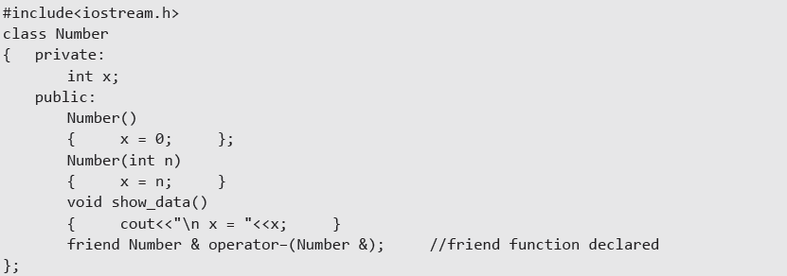
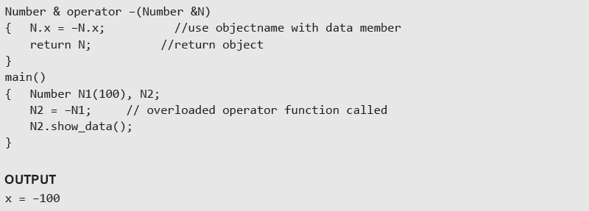
Example:- Use of friend function to overload a unary operator

Slide 12
Example Program:
Write a program which will convert an positive values in an object to negative value.
Code:
#include <iostream>
class demo
{
int x,y,z; public:
void getdata (int a, int b,int c)
{
x=a;
y=b; z=c;
}
Contd...,

Slide 13
void display(); void operator –();
};
void demo::display()
{
cout<<“x=“<<x<<“\ny=“<<y<<“\nz=“<<z<<endl;
}
void demo::operator –()
{
x=-x;
y=-y;
z=-z;
}
int main()
{
demo obj1;
CONTD...,

Slide 14
obj1.getdata(10,20,30); obj1.display();
-obj1; obj1.display(); return 0;
}
Output:
x=10
y=20 z=30
x=-10 y=-20 z=-30

Slide 15


Slide 16
INTRODUCTION
In Binary operator overloading function, there should be one argument to be passed.
It is overloading of an operator operating on two operands.

Slide 17
#include<iostream> class multiply
{
int first,second;
public:
void getdata(int a,int b)
{
first=a; second=b;
}
Contd...,

Slide 18
void display()
{
cout<<“first=“<<first<<“second=“<<secon<<endl;
}
multiply operator *(multiply c);
};
void multiply::operator *(multiply c)
{
multiply temp; temp.first=first*c.first; temp.second=second*c.second; return temp;
}
Contd..,

Slide 19
int main()
{
multiply obj1,obj2,obj3; obj1.getdata(15,20); obj2.getdata(3,45); obj3=obj1*obj2; obj3.display();
return 0;
}
Output:
45
900

